Slide 1

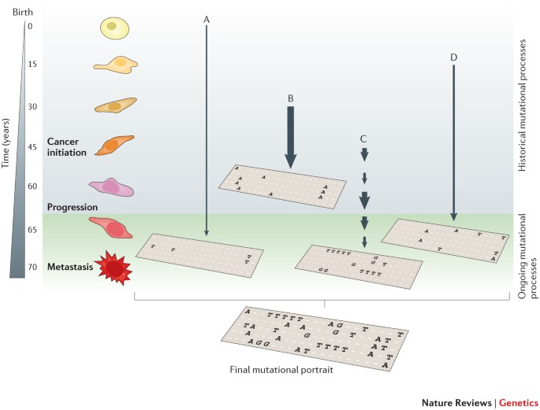

Mutational signatures
A M Mahedi Hasan, PhD | CBiol MRSB | FHEA Senior Research Associate (Computational Biology)
Treatment Resistance Group
UCL Cancer Institute

Slide 2
Mutational signature - a physiological readout of the biological history of a cancer
Mutational signatures provides an account of the mechanism and the degree to which it has been affected by this perturbation (historic and ongoing).
Driver mutations
Somatic mutations that are causally implicated in oncogenesis and that confer selective advantages during the evolution of a cancer.
Passenger mutations
may not be causative of cancer development but that are a rich source of historical information.

Slide 3
Mutational signature - a physiological readout of the biological history of a cancer
“The collective somatic mutations observed in a cancer are the outcome of multiple mutagenic processes that have been operative over the lifetime of a patient.”
Each mutagenic process leaves behind –
A mutational signature, which comprises –
Type of DNA damage(s)
DNA repair process(s)
In relation to exogenous and endogenous DNA damaging agents, as well as by the DNA replicative mechanisms
The result is –
Base substitution
Insertions and deletions
Structural variation

Slide 4
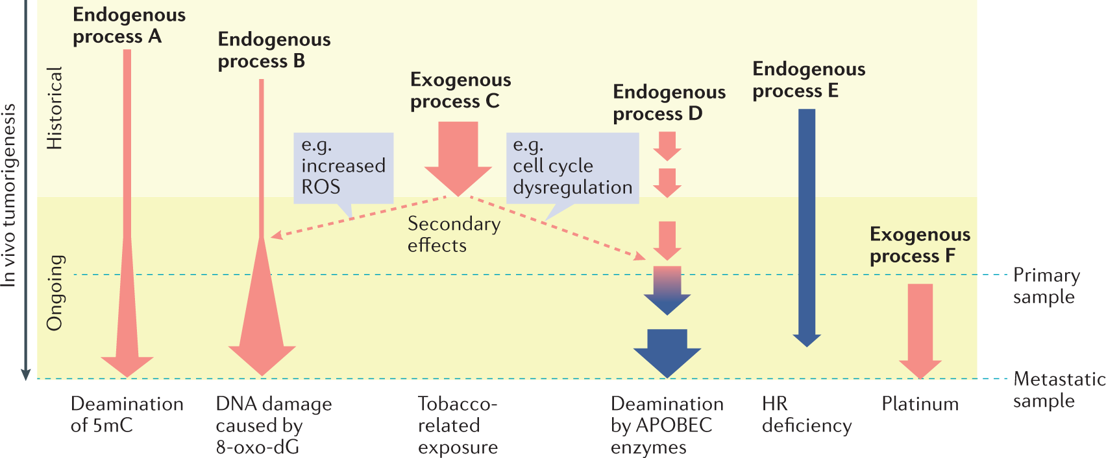
Mutational processes can be endogenous or exogenous

Slide 5
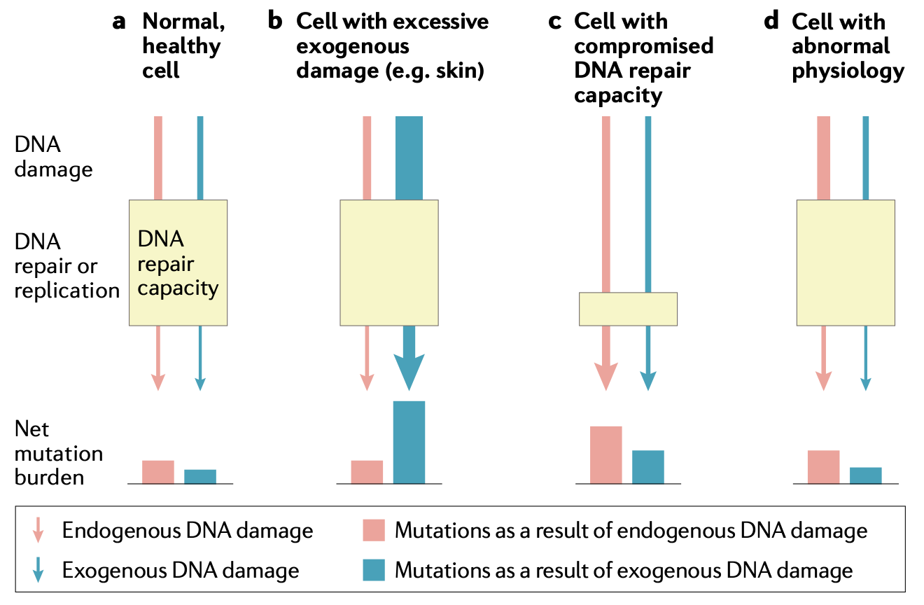
The extent of mutational process leaves its signature behind
Notes:
Nearly three­quarters of stem cell lines studied had mutation burdens that rivalled cancers
It has been postulated that there are limits to the amount of DNA damage that our cells are permitted to repair

Slide 6
The final mutational portrait is the sum of all of the different mutational processes
Deamination of
methylation on 5mC
Faulty DNA repair pathway(s)
Historical mutational processes are no longer active.
Ongoing mutational processes reflect active biological processes in the cancer that could be exploited either as biomarkers to monitor treatment response or as therapeutic anticancer targets.
Smoking
Likely clonal
Pre-metastatic
Burst of APOBECs
Clonal and/or subclonal
Notes:
Each mutational process leaves a characteristic imprint — a mutational signature — in the cancer genome and comprises both a DNA damage component and a DNA repair component. In this hypothetical cancer genome, arrows indicate the duration and intensity of exposure to a mutational process. The final mutational portrait is the sum of all of the different mutational processes (A–D) that have been active in the entire lifetime.
arrows indicate the duration and intensity of exposure to a mutational process

Slide 7
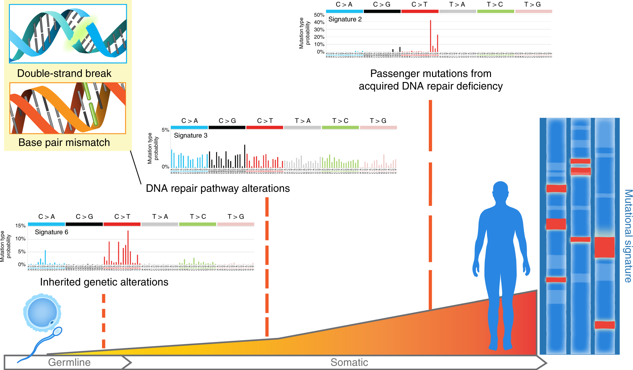
Mutational processes can be inherited or acquired during oncogenesis
An individual’s unique mutational signature is a record of the types of DNA alterations sustained throughout their lifetime
Can be studied to identify unique patterns of etiology-specific alterations, including carcinogens or DNA repair pathway defects, the latter of which can be inherited or acquired during oncogenesis.

Slide 8
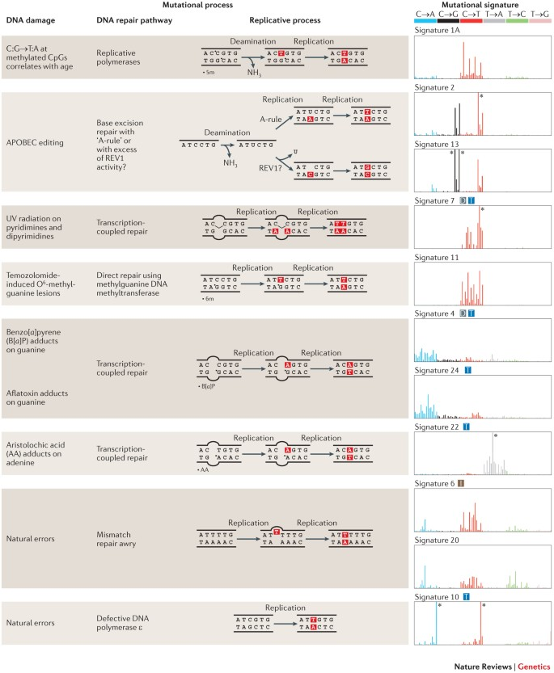
A few mutational signatures and their corresponding mutations processes

Slide 9
The algorithm for determining mutational signature
Catalogue ≈ Signature × Exposure
Exposure (total number of mutations is a proxy of the amount of each signature)
Signature
Catalogue (final mutational profile)

Slide 10
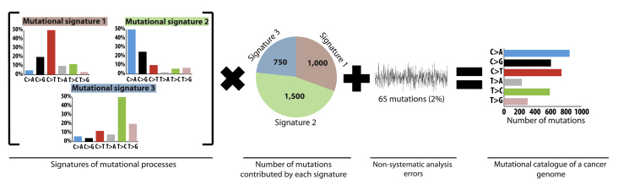
Signature × Exposure ≈ Catalogue
The process of determining Mutational Signature
Extraction
Estimating the number of signatures and their profiles
Assignment
Estimating how much of each of the signatures
is present in each sample

Slide 11
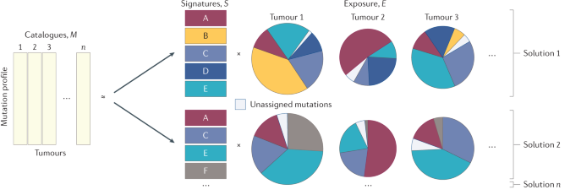
Determining mutational signatures is a multiple-solution problem
M ≈ S × E

Slide 12
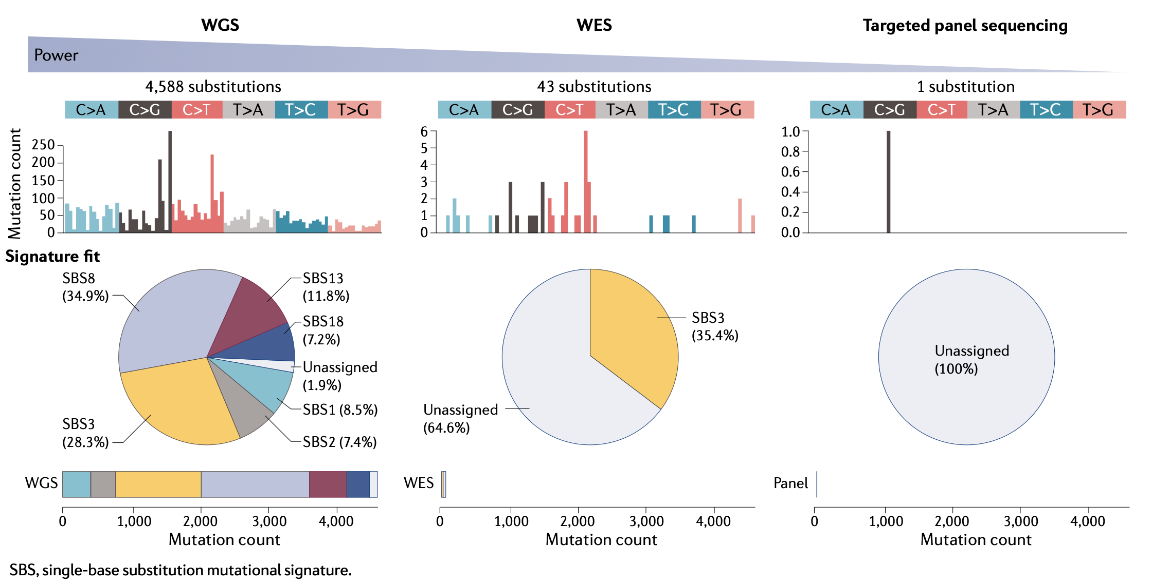
Power for signature detection with different sequencing approaches
In general, whole cancer genomes have thousands of mutations, hundreds of insertions or deletions (indels), and tens to hundreds of rearrangements. by contrast, exome-sequenced cancers have only ~1–3% of the human genome footprint (depending on the bait set used), and therefore orders of magnitude fewer mutations.
A breast cancer genome (PD6413a), whole-genome sequencing (WGS) at 40-fold depth revealed 4,588 substitutions.
A whole-exome sequencing (WES) experiment with the same sample revealed 43 mutations using 96 channels. When 43 mutations are distributed across 96 channels, the numbers of mutations may be so low as to result in many channels with counts of 0 or 1.
Targeted sequencing has an even smaller genomic footprint, and here a typical truSight oncology 500 (Illumina) targeted panel would have detected one substitution.
For WES and targeted sequencing data, indels may be down to single digits, and rearrangements would not be reported at all.

Slide 13
Approaches
Global approach of mutational signature -
Irrespective of the tissue type, signatures from all cancer types are aggregates and averaged to derive a set of consensus signatures
Presuming that more samples provide more power for discerning new signatures
Ignoring possible tissue-specific signature properties that reflect organ-specific biology (which could be probable)
Local approach of mutational signature
Restricting signature extraction within individual tissue types.
As an imbalanced tissue sampling resulted in certain tissue types being more influential and thereby introduces potential bias.
Possible to locally extracted signatures between different organs.
Notes:
Local approach is the Main approach in the past.

Slide 14
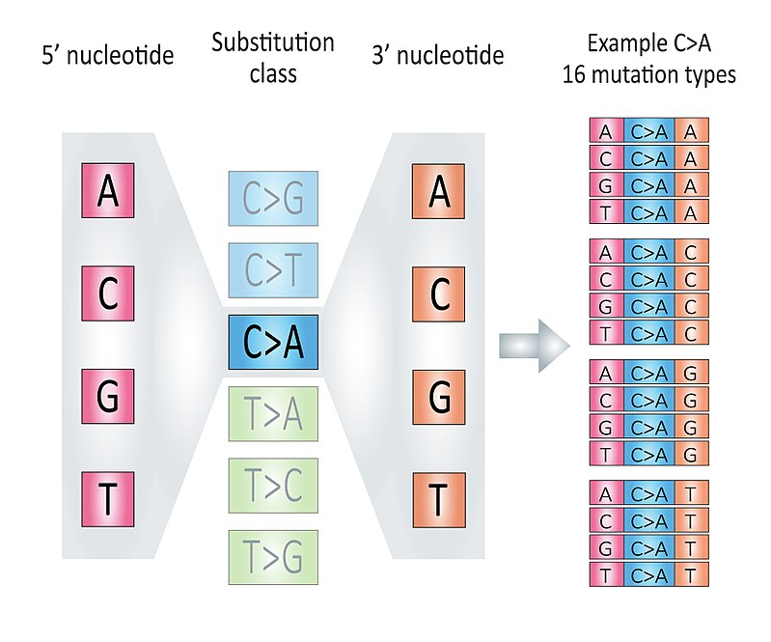
Single Base Substitution signature 6 to 96 channels
+ 80 more

Slide 15
Single Base Substitution signatures
Regardless of the algorithms used for signature identification, common signatures tend to be consistently identifiable in most cohorts examined -
SBS1, caused by deamination of 5-­methylcytosine.
Signatures associated with environmental exposures tend to be immediately demon­strable -
UV-associated SBS7 and DBS1.
Deficiencies in specific DNA repair pathways produce marked mutagenesis.
mismatch repair (MMR) deficiency ­associated SBS26 and SBS44
Some endogenous signatures are highly distinctive and easily discernible,
Apolipoprotein B mRNA­ editing enzyme, catalytic polypeptide ­like (APOBEC)-­associated SBS2 and SBS13.
Rare mutational processes that are present at low population frequencies may be more challenging to extract and will reveal themselves only if they are present in the specific cohort examined
treatment­ associated (iatrogenic) signatures.
Several othher signatures were noted as treatment related. For example, SBS31 and SBS35, associated with platinum; SBS90 attributed to duocarmycin) in COSMIC v3 collection.

Slide 16
ID signatures
Indels are common in cancers, occurring at ~10% of the frequency at which substitutions occur, and their genomic locations and sequence compositions are non­-random.
Indels cannot always be pinned to a defined coordinate with the same precision as substitutions because it is impossible to pinpoint the deleted or inserted position in a polynucleotide repeat tract. Thus, indels have been classified more simply, on the basis of their -
type (deletion, insertion or complex),
size and
whether there are features at indel junctions that could reveal biological underpinnings
1­bp indels occurring at repetitive tracts commonly arise from strand slippage during replication, whereas indels that share a micro-homologous sequence with the flanking sequence are thought to be scars of imperfect repair of double-­strand breaks by alternative end­joining processe.
To extract IDs, a global analysis of 2,780 cancers of multiple tissue types was performed on indels clas­sified according to a set of 83 channels. Seventeen IDs were reported
ID6 represented a microhomology­-mediated deletion sig­nature seen in BRCA1­mutated and BRCA2­mutated cancers described previously.
ID1, ID2 and ID7 were repeat-­mediated IDs highly elevated in tumours with mutations in the proofreading domains of POLE or POLD1 and/or MMR deficiency.

Slide 17
Rearrangement signatures
With use of NMF framework, 32 classifica­tion channels were proposed for putative RSs extracted from a local analysis of 560 WGS breast cancers
The channels took into account how the rearrangement breakpoints were regionally clustered,
the rearrangement type (for example, deletion, tandem duplication (TD), inversion or translocation) and
the rearrange­ment size.
Three of the six identified RSs cor­related with tumour HRD:
cancers with BRCA1 but not BRCA2 mutations displayed high numbers of RS3 small TDs (less than 10 kb),
cancers with BRCA1 or BRCA2 mutations showed a substantial number of RS5 deletions (less than 10 kb).
The cause of RS1 long TDs (more than 100 kb), also associated with HRD, was not known.
The number of RSs was recently extended to 15. The 32­-channel classification scheme has also been used to report signatures in liver and ovarian cancer cohorts.
Using a hierarchical Dirichlet process, the Pan­Cancer Analysis of Whole Genomes (PCAWG) Structural Variation Working Group reported 16 RSs in a global analysis of ~2,559 WGS primary cancers, involving ~150,000 structural variations

Slide 18
Thank you

